Slide 2
Introduction to Flint
Hao Yuan
1st Year M.Eng MIE Student @ U of T
www.github.com/kvyuan
www.linkedin.com/in/hao-yuan-95qd/

Slide 3
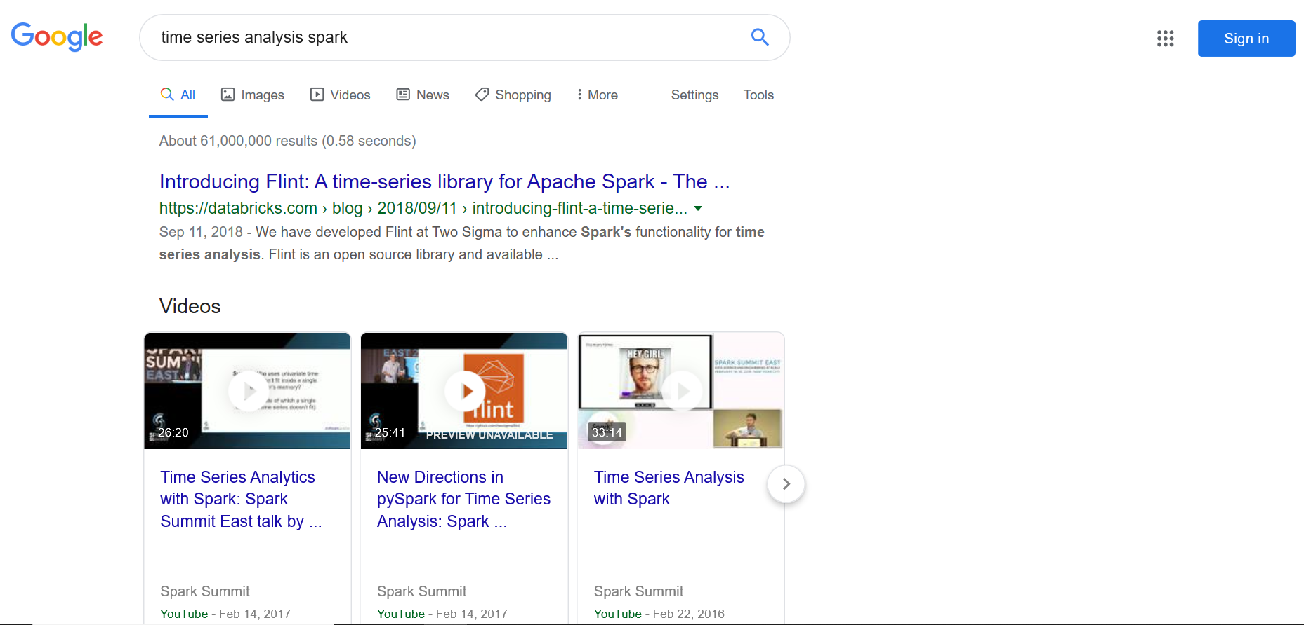
If you search time series analysis & spark

Slide 4
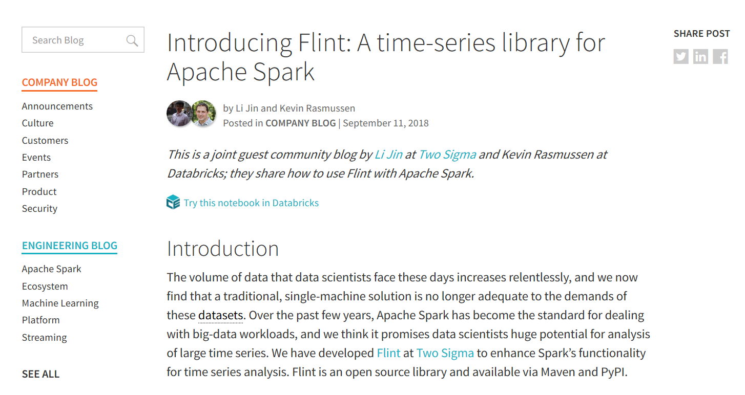
Then, you enter the blog and find out the creator: Two Sigma

Slide 5


About Two Sigma: Ranks the 5th largest hedge fund
60% of employees are from non-financial background

Slide 6
About Two Sigma: Relies on M.L. and cloud computing
42+
petabyte of Data from 10,000+ data source
335k+
CPU & 2,000+ terabyte of memory

Slide 7

About Two Sigma: Focuses on research and development
Research:
Market & Economy
Data Science
Technology
Github Repos:
Cook Scheduler
Webtau
Waiter
Flint

Slide 8
Flint: A time series library with time aware data structure
Focuses on data manipulation rather than data modeling
began as an internal library used at production level
Open-source project started in 2016, not much update since Oct 2018
Two flavors: Scala and Pyspark
In this session, I will cover:
Flint installation process
Functionalities of Flint and analyze how they are achieved
Flint vs other libraries
Lessons learned

Slide 9
Install and configure Flint for Pyspark
1st try:
Installed from artifact: pip3 install ts-flint
Imported ts.flint and tried to create a flint dataframe
TypeError: ‘JavaPackage’ object is not callable
Why: a JAR file missing
README @ https://github.com/twosigma/flint:

Slide 10
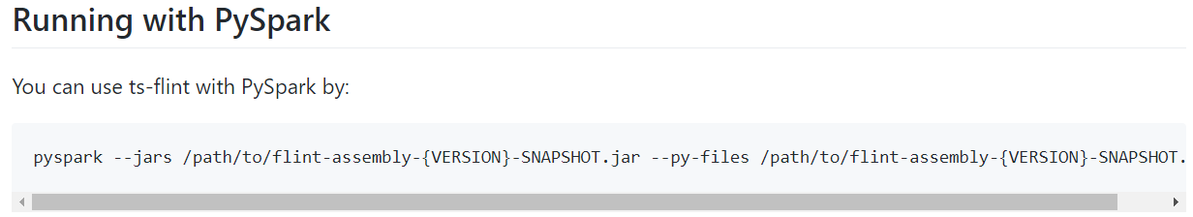
Install and configure Flint for Pyspark
2nd try:
Downloaded flint-0.6.0.jar and placed in hadoop jar directory
Imported ts.flint and tried to create a flint dataframe
TypeError: ‘JavaPackage’ object is not callable
Why: pyspark didn’t know this new JAR file is available for use
README @ https://github.com/twosigma/flint/tree/master/python:

Slide 11

Install and configure Flint for Pyspark
3rd try:
pyspark --jars flint-0.6.0.jar --py-files flint-0.6.0.jar
Imported ts.flint and created a flint dataframe named flint_df
flint_df.show()
An error occurred while call o348.showString
Caused by java.lang.NoClassDefFoundError: Could not initialize class com.twosigma.flint.rdd.PartitionsIterator$
Why: flint-0.6.0.jar’s dependencies incomplete
Not in README but in https://github.com/twosigma/flint/issues/77:

Slide 12
Install and configure Flint for Pyspark
4th try:
Downloaded grizzled-slf4j_2.11-1.3.4.jar and placed in hadoop jar directory
pyspark --jars flint-0.6.0.jar, grizzled-slf4j_2.11-1.3.4.jar --py-files flint-0.6.0.jar, grizzled-slf4j_2.11-1.3.4.jar
Imported ts.flint and created a flint dataframe named flint_df
flint_df.show()
It finally worked : )

Slide 13
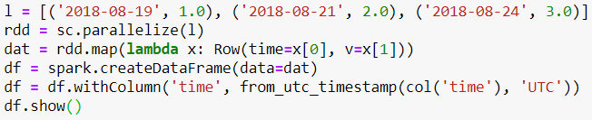
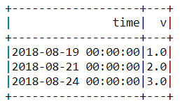
Here is how to generate a flint dataframe
Step 1: create a pyspark dataframe
Code:
Output:

Slide 14

Here is how to generate a flint dataframe
Step 2: create a flint dataframe based on pyspark dataframe
Code:
Output:

Slide 15
Wait a second, they look the same!
If we check the type of the flint dataframe
Code:
Output:

Slide 16
Ok, where is time awareness added to this data structure?
IT IS NOT ADDED...YET

Slide 17
So when will it be added then?
WHEN YOU DO SOMETHING TO THE DATAFRAME

Slide 18
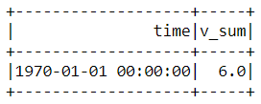
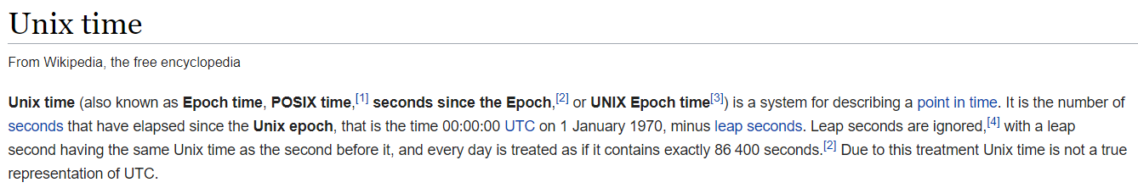
Let’s do something then!
Code:
Output:

Slide 19
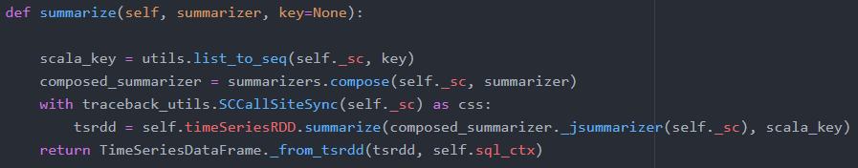
What happened? Let’s read the source code!
Code:
Behind the scene: dataframe.py
Notes:
dataframe.py @ https://github.com/twosigma/flint/tree/master/python/ts/flint

Slide 20
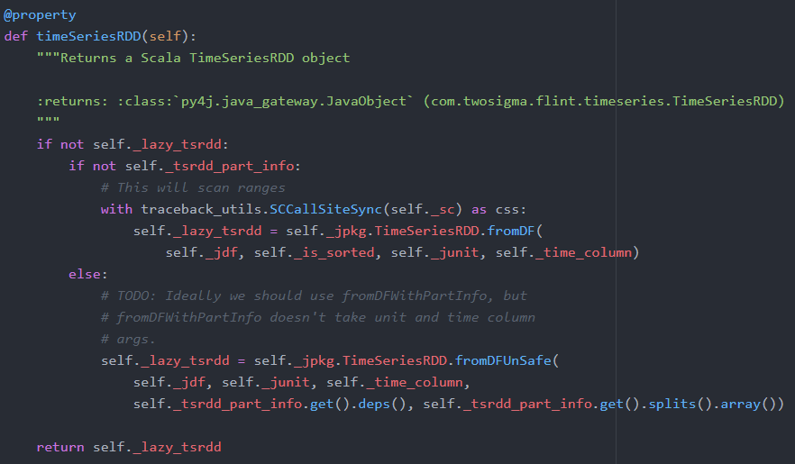
What happened? Let’s read the source code!
Code:
dataframe.py
Notes:
dataframe.py @ https://github.com/twosigma/flint/tree/master/python/ts/flint

Slide 21
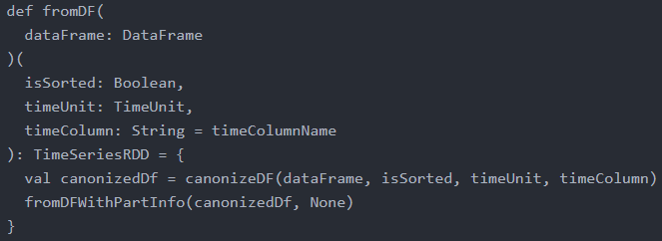

Is time awareness added here?
TimeSeriesRDD.scala
Notes:
TimeSeriesRDD.scala @ https://github.com/twosigma/flint/tree/master/src/main/scala/com/twosigma/flint/timeseries

Slide 22
Yes! It is added when we first created a TimeSeriesRDD
TimeSeriesRDDImpl contains more than 650 lines of code
TimeSeriesDF[cols] -> TimeSeriesRDD[(key, row)]
key = row[time].convertToNanoSinceEpoc()
Partitions preserved
Notes:
TimeSeriesRDD.scala @ https://github.com/twosigma/flint/tree/master/src/main/scala/com/twosigma/flint/timeseries
convertToNanoSinceEpoc() a pseudo function, not in the scala file

Slide 23

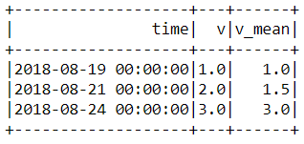
It makes looking back/forward easier
Example: Calculation of Moving Average
Code:
Output:

Slide 24
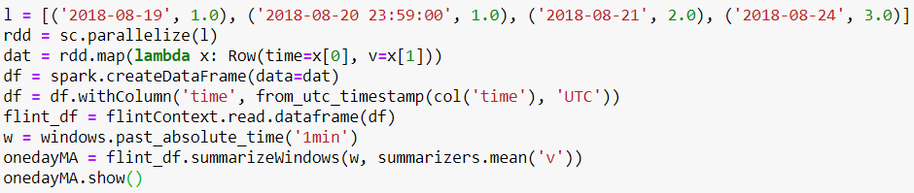
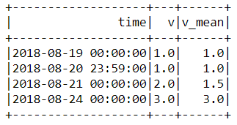
You can customize time unit with no hassles
Code:
Output:

Slide 25
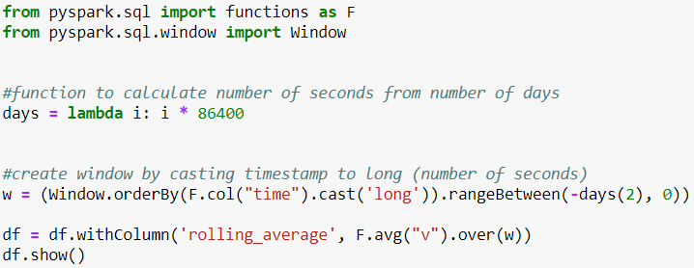
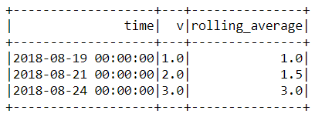
Good news, there is an equivalent way to do this in pyspark!
Code:
Output:

Slide 26
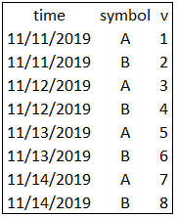


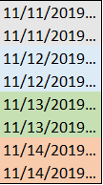


However, when partitioning comes into play… shuffle cost
Partitioned
GROUP BY
ORDER BY

Slide 27
Then, let’s iterate through each partition instead (TimeSeriesRDD)!
Partitioned
GROUP BY

Slide 28



Because of that, misaligned timestamps can be handled.
Left Table
Right Table
Joined Table
Join with 3-day tolerance

Slide 29

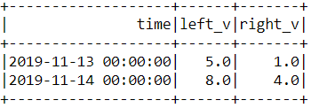
Putting that into code, we have
Code:
Output:

Slide 30
What about other libraries?
spark-ts developed by developers working for Cloudera
Started earlier than Flint
Instead of nano since epoch, it sets the earliest time in the dataset as 0
Stopped development since March 2017
When do you not use spark-ts
Multivariate time series
Misaligned time stamps

Slide 31
Lessons I learned from exploring Flint
User
Read documentations carefully
Try github issues and you may find people who run into same problems as you
Read source code rather than rely on tutorials
Developer
Don’t assume your users know as much you know
Update documentations coherently
Use file headers to explain the purpose of this file, easier for future use and development

Slide 32

Q & A

Slide 33
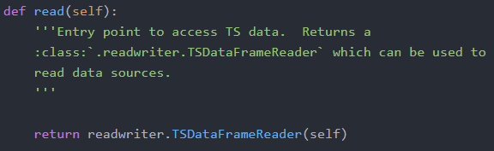
What happened? Let’s read the source code!
Code:
Behind the scene: context.py
Notes:
context.py @ https://github.com/twosigma/flint/tree/master/python/ts/flint

Slide 34
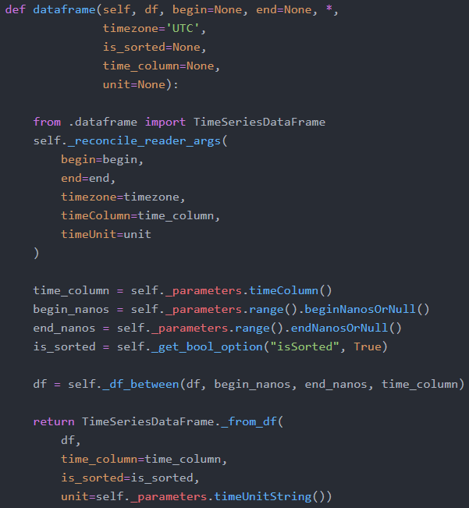
What happened? Let’s read the source code!
Code:
Behind the scene:
readwriter.py
Notes:
readwriter.py @ https://github.com/twosigma/flint/tree/master/python/ts/flint

Slide 35
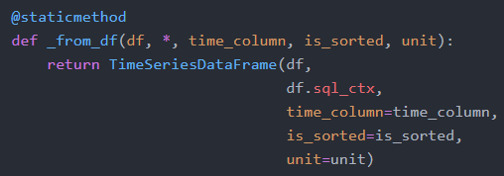
What happened? Let’s read the source code!
Code:
Behind the scene: dataframe.py
Notes:
dataframe.py @ https://github.com/twosigma/flint/tree/master/python/ts/flint

Slide 36
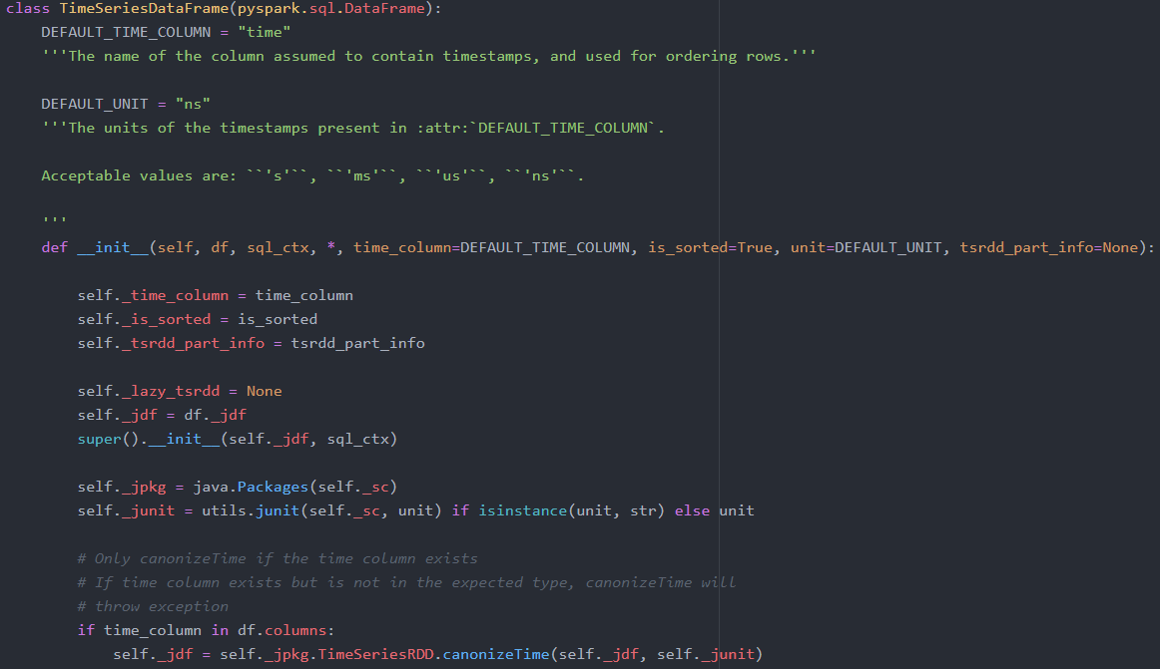
What happened? Let’s read the source code!
dataframe.py
Notes:
Dataframe.py @ https://github.com/twosigma/flint/tree/master/src/main/scala/com/twosigma/flint/timeseries

Slide 37
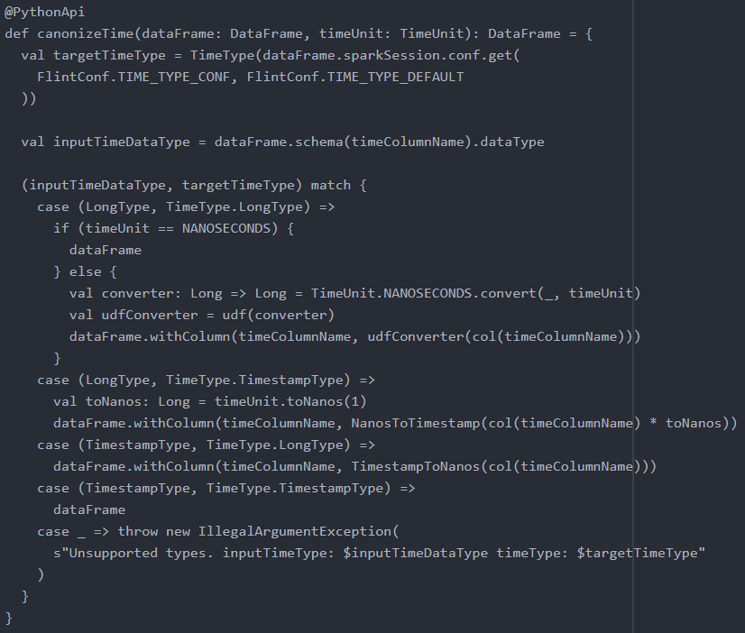
Is time awareness added here?
FlintConf.scala
val TIME_TYPE_DEFAULT = "timestamp"
TimeSeriesRDD.scala
Notes:
TimeSeriesRDD.scala @ https://github.com/twosigma/flint/tree/master/src/main/scala/com/twosigma/flint/timeseries

Slide 38
Recall how we created the flint dataframe...
Checked inputs
Wrapped a pyspark dataframe as a flint dataframe
No time manipulation
Mostly in python

